Slide 1
L'ARTISTA
FOOD TRUCK SERVICE

Slide 2
Highlights
 WEB GALLERY LINK
«Unsere Meister-Pizzaioli sind wieder unterwegs. Wir erwarten Euch bei unseren Stops in der ganzen Schweiz!»
«I nostri Maestri Pizzaioli sono di nuovo on the road. Vi aspettiamo nelle nostre tappe in tutta la Svizzera!»
«Our Pizza Chefs are back on the road. We are waiting for you in our stages throughout Switzerland!»
Food Truck Festival BASILEA (BS)
Notte Bianca
LOCARNO (TI)
Züri Fäscht
ZURIGO (ZH)
Food Truck Festival SBB
BERNA (BE)

Slide 3
Numbers
1
Autonomy-Day in whole Switzerland
2
Pizzaioli Masters
Pizzas sold every hour
150
150
Sandwiches sold every hour
1’000
Guaranteed Meals in whole Switzerland

Slide 4
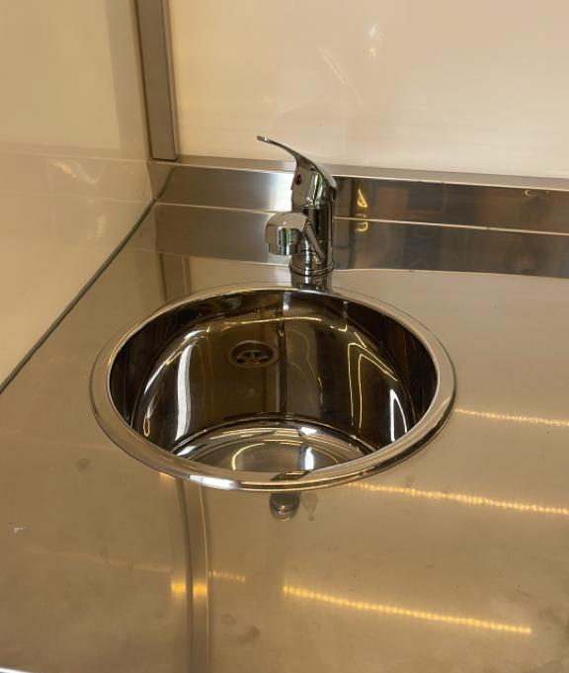
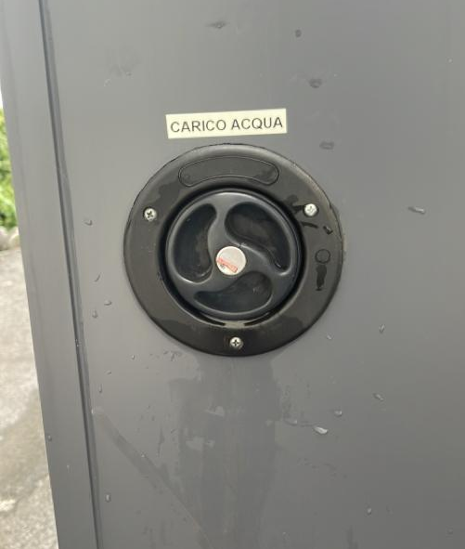
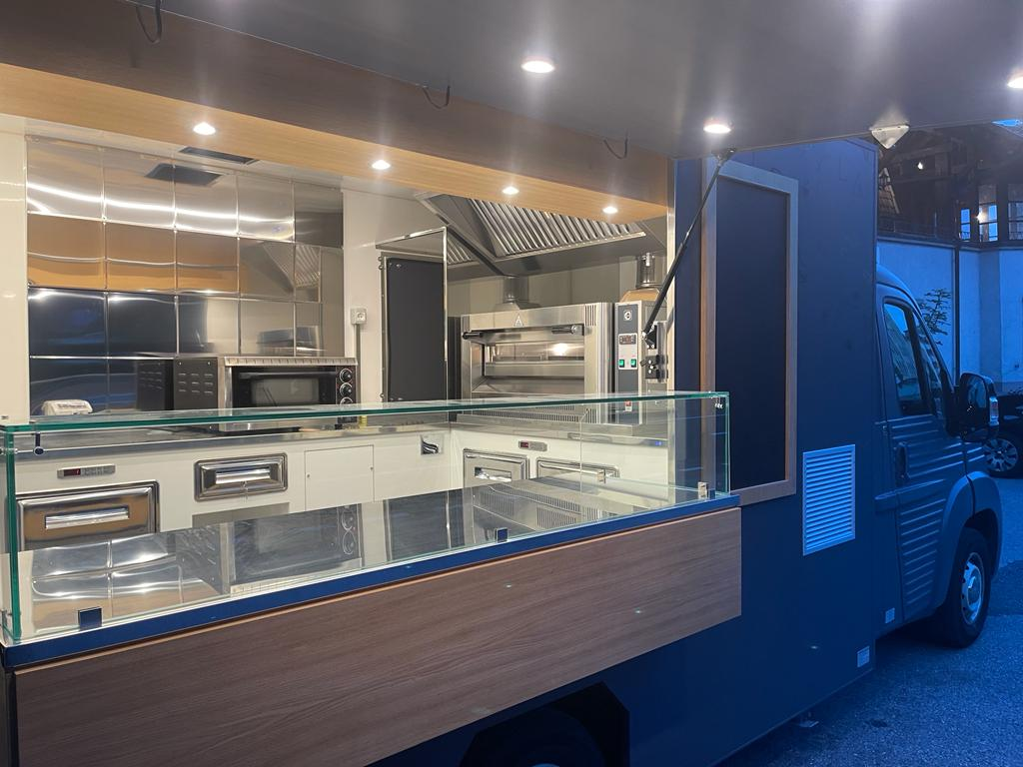
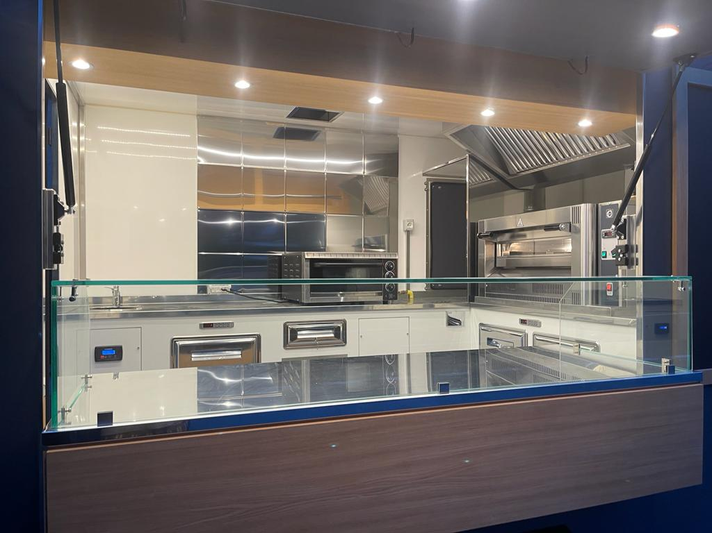
Gear
Technical Specifications
1 Double Mouth Oven (power 380V / 20Kw)
2 Grills (power 220V)
1 Double Arm Coffee Machine (power 220V)
2 Extractor Hood
3 Fridges (under top)
1 Sink (30lt water)
1 Rear Counter (incl. gas compartment)
1 Storage Compartment
1 Pizza Preparation Area (with refrigerated GN bowls)
Set up dimensions: Length: 6,50 mt – Width: 3 mt – Hight: 2,90 mt
Lighting: 3000K LED
Generator TEC29 + Generator (380V / 20Kw)
Independent Water System, with hot water
Electrical System: 230V 16A
Storage Area
Sliding Counter on front side, with neutral glass showcase for products presentation.

Slide 5
Services
Products
 IN PARTNERSHIP WITH
Catering (e.g. weddings, etc...)
City Festival (e.g. Street Food, White Night, etc...)
Musical Events
Sport Events
Company Events
Fair, Exhibitions
Italian Antipasto (cold meats and cheese)
Finger Food
Pizza (classic & "portafoglio")
Sandwiches
Pasta
Beverage

Slide 6
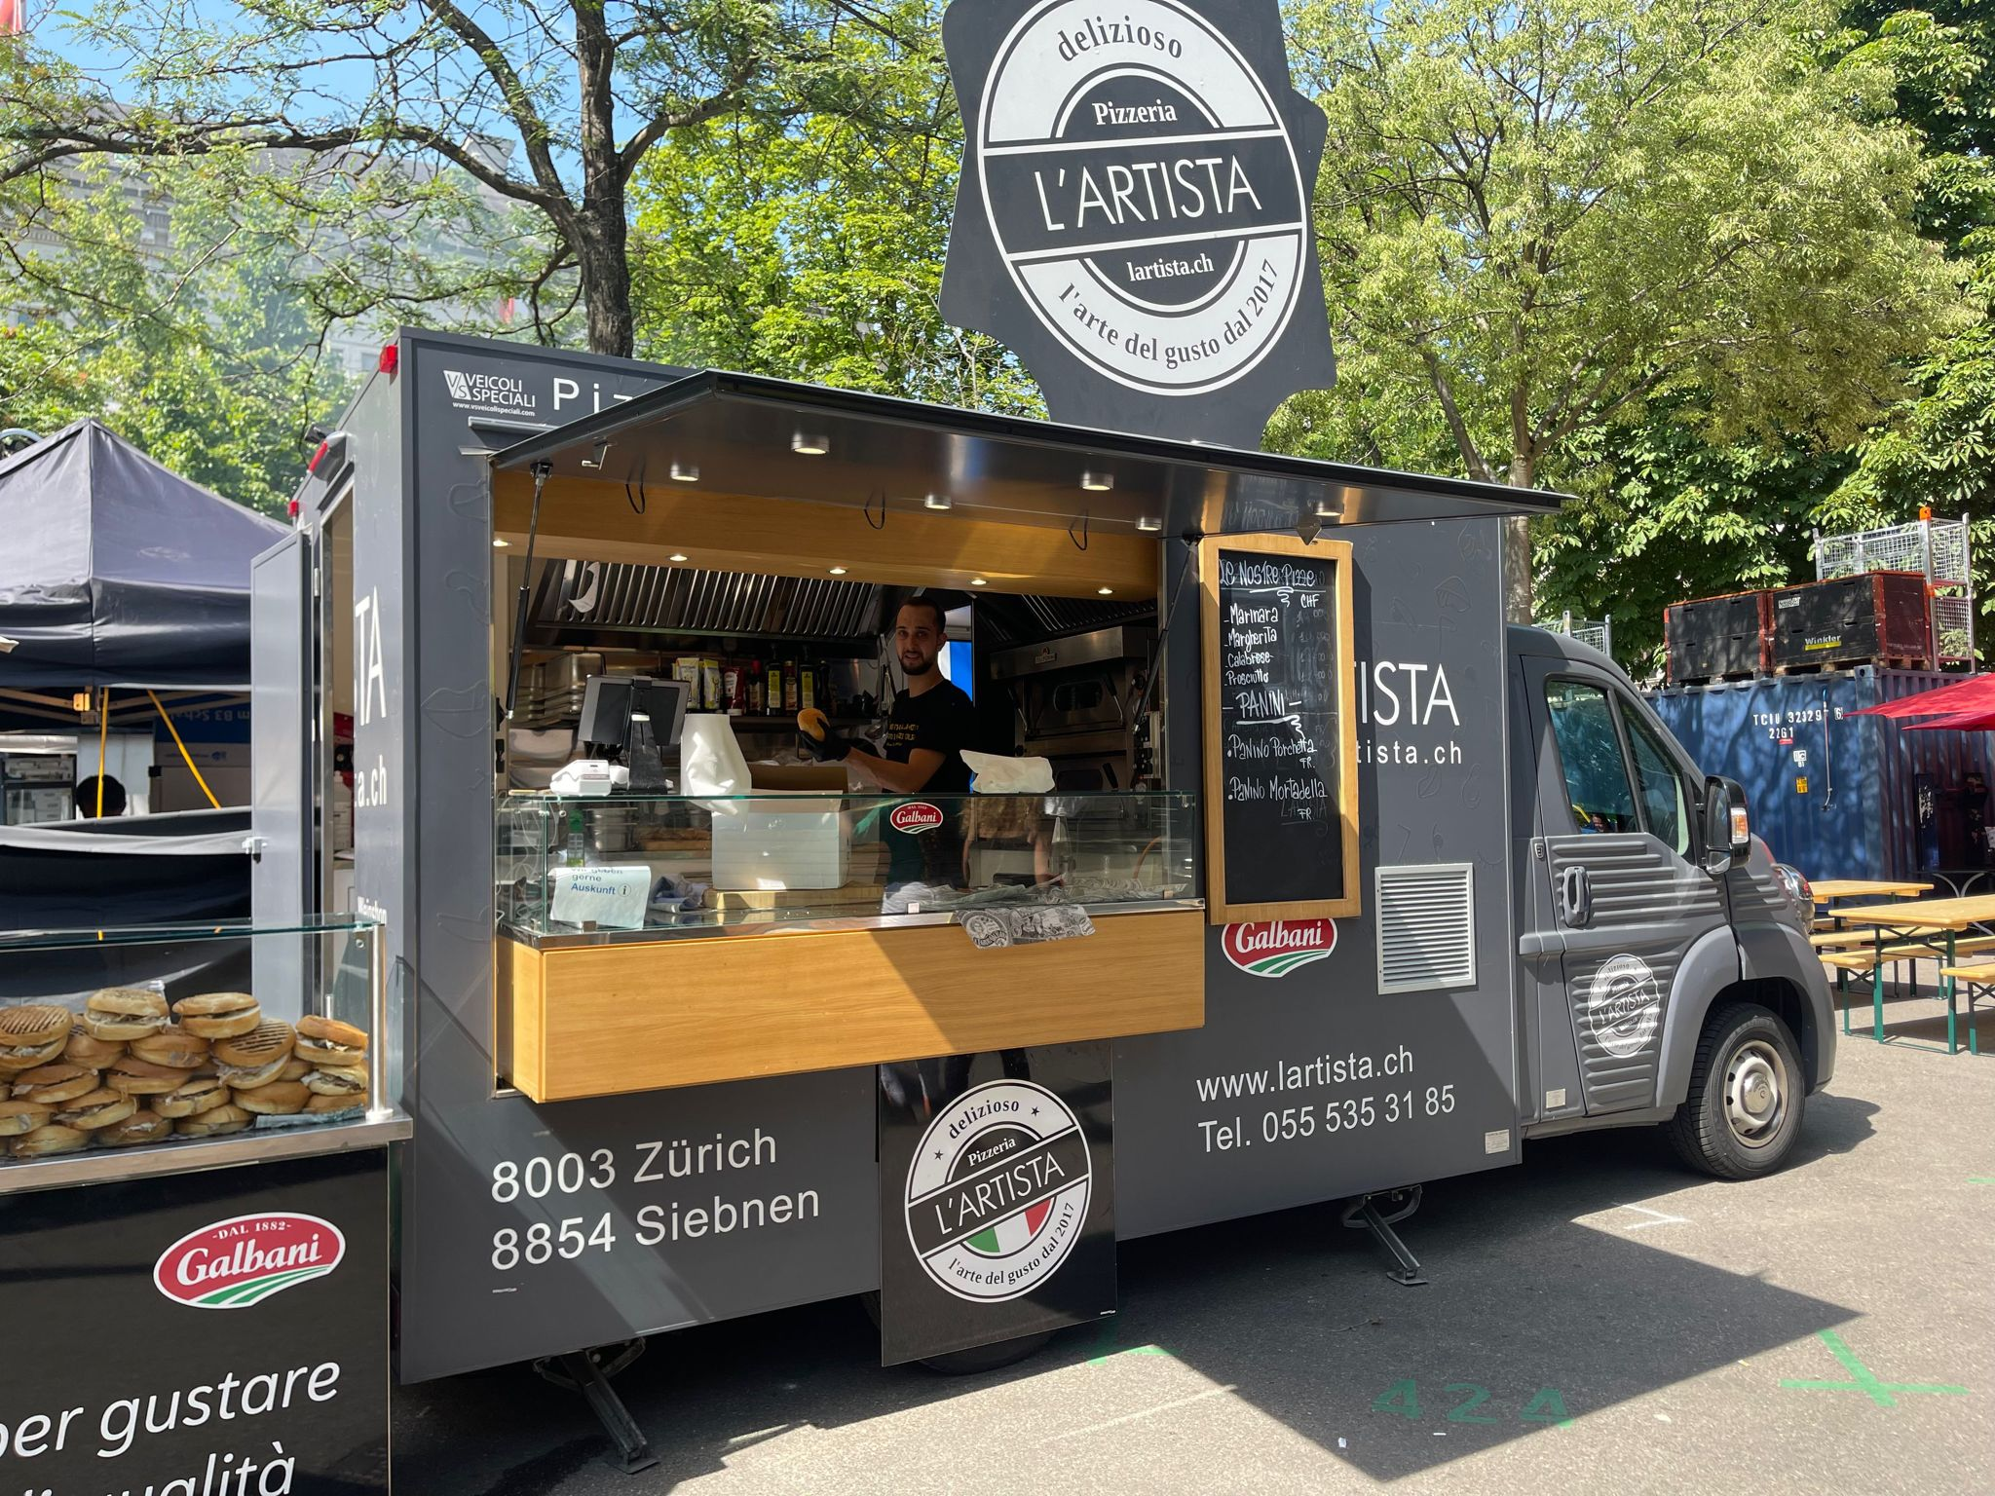
Benefits
Autonomy in preparation and travel
Food guarantee thanks to the use of first choice products
Authentic Italian taste
Food Truck equipment and interior respect all Swiss hygiene regulations.

Slide 7
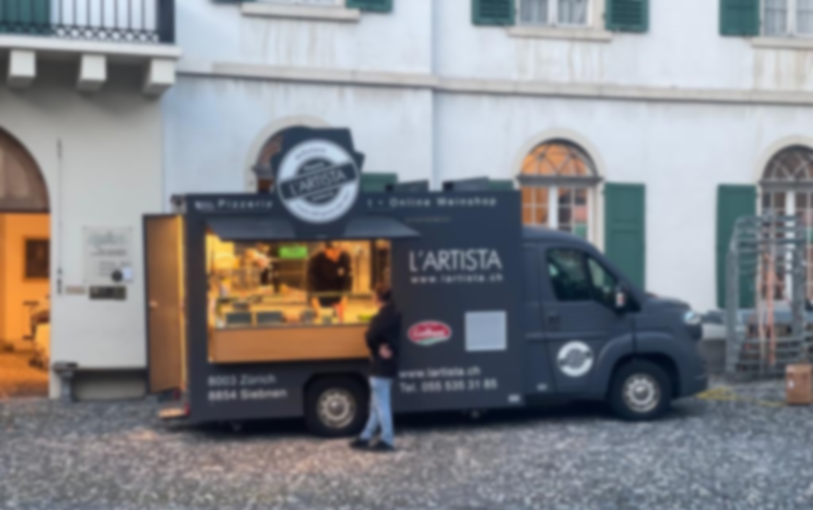
CONTACTS
+41 78 740 45 89
@lartista_foodtruck
www.lartista.ch/food-truck
Download Food Truck Menu

